Slide 1
The Schlieffen Plan

Slide 2
Western Front Trenches and the Eastern Front

Slide 3
WWI: The Homefront
Ch 7 Sec 2

Slide 4
Organizing the Economy
World War I was a total war.
America had a PROGRESSIVE government during WWI.
What did progressives believe?
How will they deal with the war?
EXPAND THE SIZE OF THE GOVERNMENT TO SERVE THE NEEDS OF WAR.

Slide 5
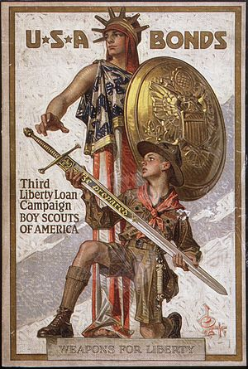
Organizing the Economy
Wartime Agencies
War Industries Board
Food Administration
Fuel Administration
Total spent on war: $32 billion
Funded by raising taxes, including income taxes, and borrowing $20 billion in war bonds.

Slide 6
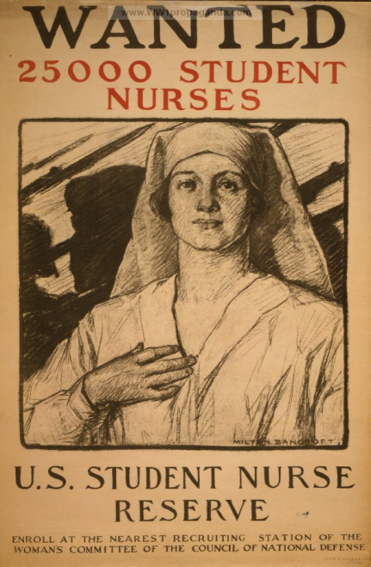
Organizing the Economy
Mobilizing the Workforce
National War Labor Board
Cooperation of workers; prevent strikes
African American “Great Migration” north
Women enter work force
100,000 Mexicans migrated to the U.S. for work
Shaping Public Opinion
Committee on Public Information
“sell” the war to Americans
Celebrity endorsements and propaganda

Slide 7
Organizing the Economy
Supreme Court Limits Free Speech
Espionage Act (1917)
Sedition Act (1918)- government can restrict speech if it presents “clear and present danger”

Slide 8
Building the Military
Volunteers and Conscripts
Even though a draft is not “progressive”, Congress agreed it was necessary.
Selective Service Act (1917)- all men between 21 and 30 must register for draft.
Lottery by local boards.
2.8 million Americans drafted
Including 400,000 African Americans in segregated units
2 million volunteered
12,000 Native Americans
20,000 Puerto Ricans Mostly volunteers
15,000 Mexican Americans

Slide 9
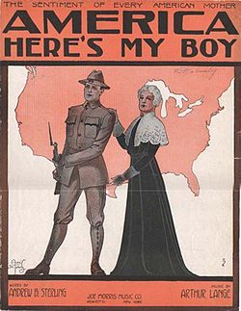
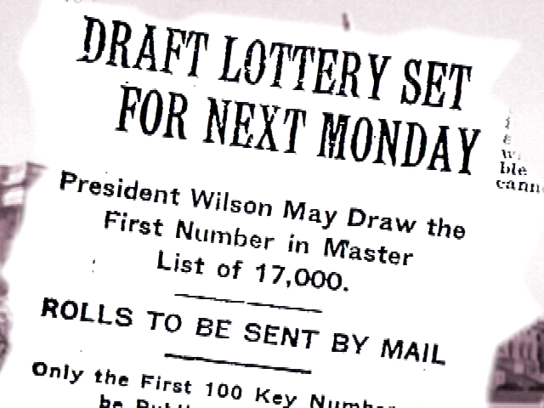

Slide 10
Building the Military
Women
Officially serve in Army and Navy (non-combat)
Clerks, radio operators, electricians, pharmacists, chemists, photographers
20,000 Army Nurse Corps
Gained suffrage in 1920 largely due to war contributions

