Slide 1
WWII

Slide 4
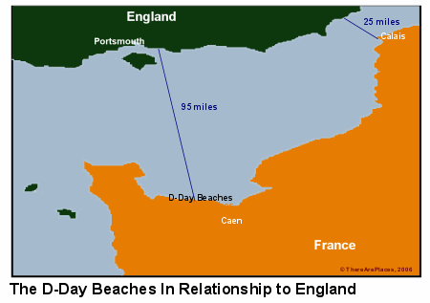
D-Day Preparations

