Slide 1
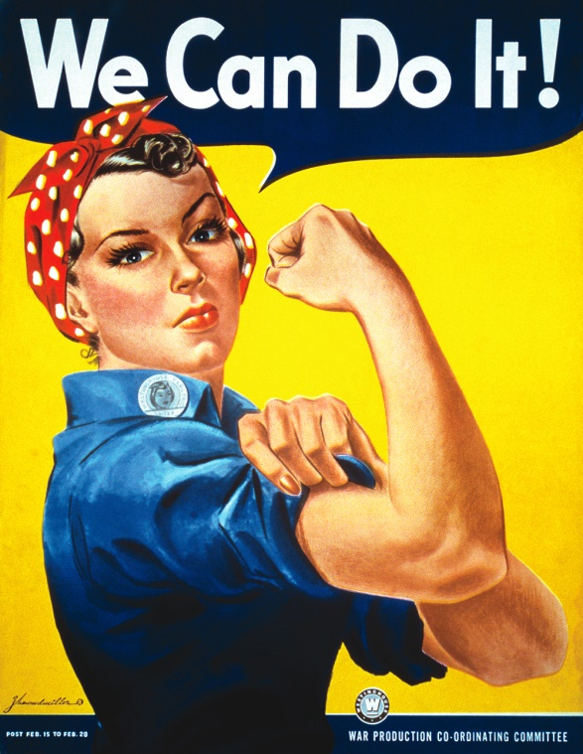
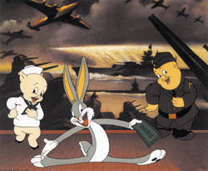
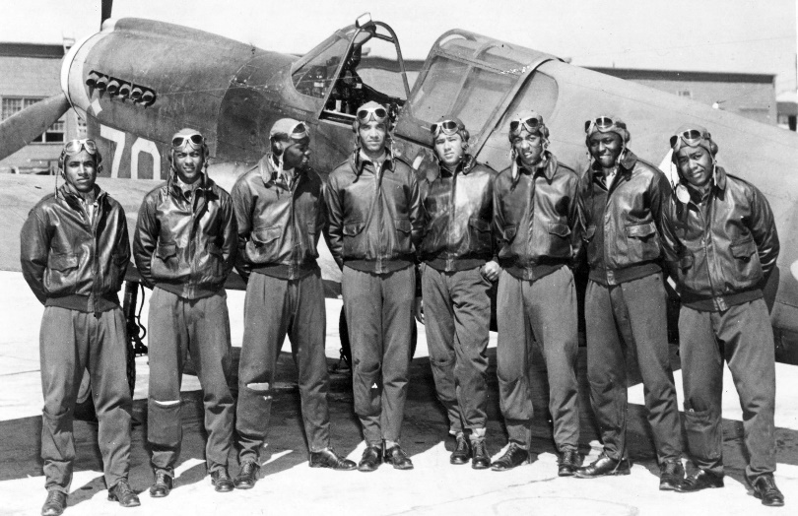
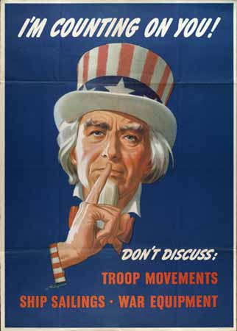
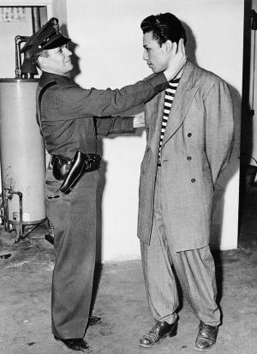
The AMERICAN HOMEFRONT

Slide 2
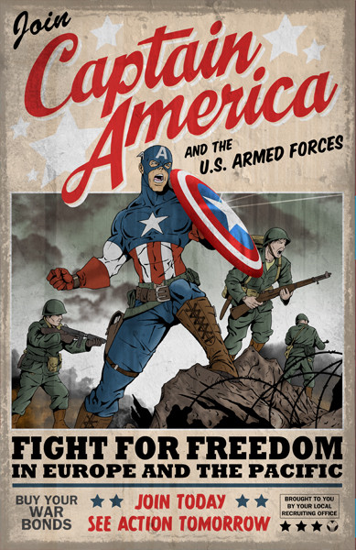
The Military
How did the military adjust to new recruits?

Slide 3
The Military
Before WWII, U.S. ranked 19th in strength (behind Belgium) and had only 190,000 men.
FDR added 40,000 men after Sep. 1939.
60,000 enlisted after Pearl Harbor.
Selective Training and Service Act- a peacetime draft.
Gen. George C. Marshall coordinated recruits and enlistments; organized army bases.
By 1945, the U.S. Armed Forces numbered over 8 million.

Slide 4
The Economy
Government had to build thousands of war planes and a “two-ocean” navy.
Business leaders served on National Defense Advisory Committee (government and business had to work together for the war effort).
Instead of getting companies to bid on war contracts to produce war good, government used a cost-plus system- they just directly paid the cost to produce something.
Companies quickly went into war production.

Slide 5
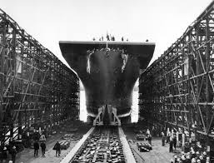
The Economy
Henry Ford:
Auto industry perfectly set up to produce jeeps, tanks, weapons, and bombers.
Henry Kaiser: Shipyards
“Liberty” Ships had to be built quickly- put together out of pre-fabricated parts.

