Slide 1
WWII and the Atomic Bomb

Slide 2
WWII Technology
Machine Guns: Bigger faster and more deadly
Improved airplanes: dropped bombs
Bigger deadlier bombs
Sonar: used to detect submarines
Radar: used to detect airplanes
Walkie-talkies
Faster more improved tanks
Faster more improved airplanes
Faster more improved submarines
Aircraft carriers
Medical advances

Slide 3
WWII Facts
The majority of deaths in WWII were civilian deaths.
Allied leaders did not trust each other.
The Japanese fought with ruthless stubbornness, and refused to surrender.
The Japanese used kamikaze attacks against the U.S.
Americans still held bitter resentment after Pearl Harbor.
The Japanese were known for ruthless treatment of POWs.

Slide 4
Before May 1945

Slide 5
WWII Ends: A Timeline
February 1945: The Yalta Conference.
Roosevelt, Churchill, and Stalin agree to divide Germany into 4 sectors
Soviets “liberate” Poland and set up a communist government there.
Stalin pressures Romania into establishing communist government.
Tensions between the US and USSR intensify.
February 1945: Battle of Iwo Jima: Nearly 7,000 Americans die.
March- June 1945: Battle of Okinawa. 12,000 Americans die.
April 1945: FDR, Mussolini, and Hitler die
May 7, 1945: Germany surrenders

Slide 6
WWII Ends: A Timeline
August 6, 1945: The U.S. drops an atomic bomb on Hiroshima.
70,000 civilians killed
August 8: The Soviet Union declares war on Japan
August 9: The U.S. drops a second bomb on Nagasaki
35-50,000 civilians killed
Japan surrendered unconditionally (Emperor Hirohito was taken out of power)

Slide 7
Europe After WWII

Slide 10
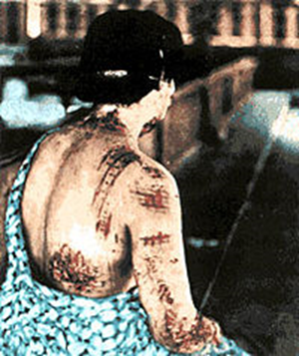
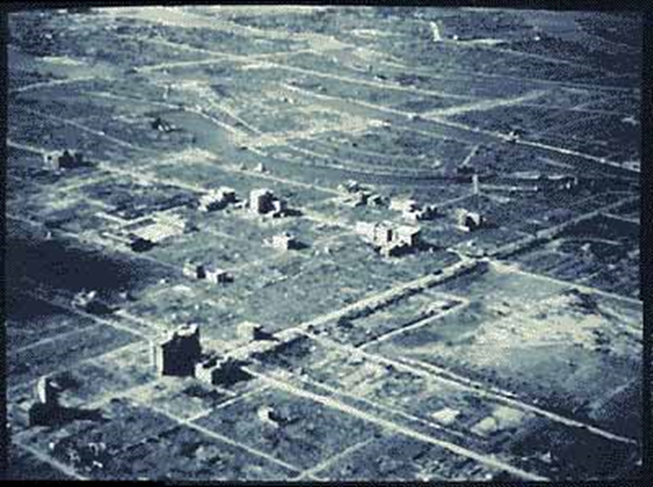

Slide 11
Argue: Was the bomb justified?
Use the fact sheets and Historical Documents to collect arguments for and against the use of the bomb.
Create a T-chart with your group listing all arguments on large poster.
Come up with a list of alternative options the U.S. could have possibly used instead of dropping the two bombs on Hiroshima and Nagasaki on a second poster.

